Slide 1
Modeling Sequential Circuits Examples

Slide 2

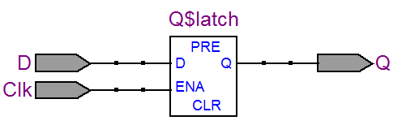
D Latch
module test(Clk, D, Q);
input Clk, D;
output reg Q;
always @(Clk, D)
if (Clk)
Q <= D;
end
endmodule

Slide 3
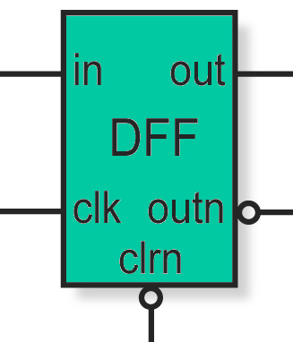
D Flip-Flop with Asynchronous Reset
module DFF(in, clk, clrn, out, outn);
input in, clk, clrn;
output out, outn;
wire in, clk, clrn; // not necessary – default is wire
reg out, outn; /* you can define the type while declaring
the outputs : output reg out, outn; */
always @(posedge clk or negedge clrn) begin
if (~clrn) begin
out <= 0;
outn <= 1;
end
else begin
out <= in;
outn <= ~in;
end
end
endmodule

Slide 4
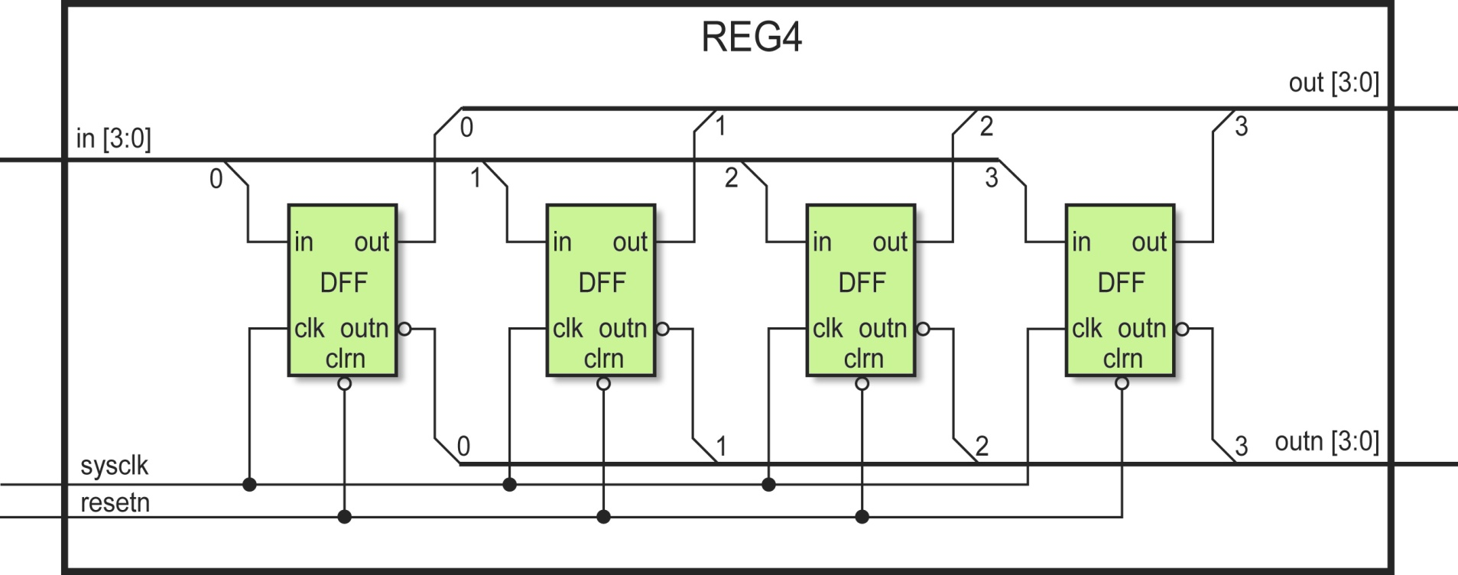
4-bit register using DFF(Nested Modules)

Slide 5
4-bit register using DFF(Nested Modules)
module REG4(in, clock, resetn, out, outn);
input [3:0] in;
input clock, resetn;
output [3:0] out, outn;
DFF ff0(in[0], clock, resetn, out[0], outn[0]);
DFF ff1(in[1], clock, resetn, out[1], outn[1]);
DFF ff2(.clrn(resetn), .out(out[2]), outn(outn[2]), .in(in[2]), .clk(clock)); /* the arguments don’t need to be in original order */
DFF ff3(.out(out[3]), .outn(outn[3]), .in(in[3]), .clk(clock), .clrn(resetn));
endmodule

Slide 6
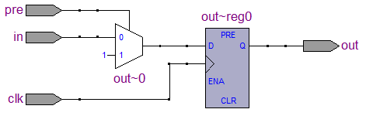
D Flip-Flop with Synchronous Preset
module DFF(in, clk, pre, out);
input in, clk, pre;
output reg out;
always @(posedge clk) begin
if (pre) begin
out <= 1;
end
else
out <= in;
end
endmodule

Slide 7
BCD Counter with Asynchronous Reset
module counter(Clk, Q, Res);
input Clk, Res;
output reg [3:0] Q;
always @(posedge Clk, posedge Res)
if(Res)
Q <= 4'd0;
else if(Q != 4'd9)
Q <= Q + 4'd1;
else
Q <= 4'd0;
endmodule
else
Q <= (Q+1) % 10;

Slide 8
2-digit BCD Counter with Synchronous Reset
module test(Clk, Q, Res);
input Clk, Res;
output reg [7:0] Q;
always @(posedge Clk)
if(Res)
Q <= 4'd0;
else if(Q[3:0] == 4'd9)
begin
Q[3:0] <= 4'd0;
Q[7:4] <= Q[7:4] + 4'd1;
end
else
Q[3:0] <= Q[3:0] + 4'd1;
endmodule

Slide 9
Shift-Register(left/right) with Asynchronous reset and Synchronous Load
module register(Clk, Q, BitIn, Res, R_L, ld, Load);
input Clk, BitIn, Res, R_L, ld;
input [7:0] Load;
output reg [7:0] Q;
always @(negedge Clk, posedge Res)
if(Res)
Q <= 8'd0;
else if(ld)
Q <= Load;
else if(R_L)
Q <= {BitIn, Q[7:1]};
else
Q <= {Q[6:0], BitIn};
endmodule

Slide 10
Finite State Machine
Mealy: Output depends on the “current state” and the “input”.
Moore: Output depends only on the “current state”.

Slide 11
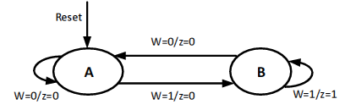
Mealy Machine
module mealy(Clock, W, Resetn, z);
input Clock, W, Resetn ;
output reg z ;
reg CS, NS;
parameter A = 1'b0, B = 1'b1;
always @(W, CS)
case (CS)
A: if (W == 0) begin
NS = A; z = 0; end
else begin
NS = B; z = 0; end
B: if (W == 0) begin
NS = A; z = 0; end
else begin
NS = B; z = 1; end
endcase
always @(posedge Clock, negedge Resetn)
if (Resetn == 0)
CS <= A;
else
CS <= NS;
endmodule
CS: Current State NS: Next State W: input z: output

Slide 12
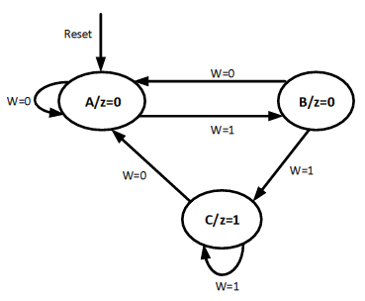
Moore Machine
module moore (Clk, w, Resetn, z);
input Clk, W, Resetn;
output z;
reg [1:0] CS, NS;
parameter A= 2'b00, B=2'b01, C=2'b10;
always @(W, CS)
begin
case (CS)
A: if (W == 0) NS = A;
else NS = B;
B: if (W == 0) NS = A;
else NS = C;
C: if (W == 0) NS = A;
else NS = C;
default: NS = 2'bxx;
endcase
end
always @(posedge Clk, negedge Resetn)
begin
if (Resetn == 0)
CS <= A;
else
CS <= NS;
end
assign z = (CS == C);
endmodule
CS: Current State NS: Next State
W: input z: output

Slide 13
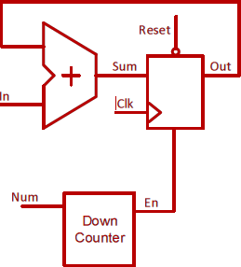
Accumulator
module test(in, Num, Clk, Rst, Out);
parameter k = 8;
parameter m = 4;
input [k-1:0] in;
input [m-1:0] Num;
input Clk, Rst;
output reg [k-1:0] Out;
wire [k-1:0] Sum;
reg [m-1:0] C;
wire En, Cout;
defparam stage0.n = k;
RippleCarryAdder stage0 (.Cin(0), .X(In), .Y(Out), .S(Sum), .Cout(Cout));
always @(posedge Clk, negedge Rst)
if (Rst == 0)
begin
C <= Num;
Out <= {k{1’b0}};
end
else if (En)
begin
C <= C-1;
Out <= Sum;
end
assign En = |C;
endmodule

